Slide 1
EMAIL FROM EMPLOYER
An example of email sent to the applicant by the employer to initiate the assessment process.
The paragraphs that present Velocity are marked in brackets.
To: Applicant
From: [EMPLOYER]
Email Subject: Your Job Application to DigiTech
Preview Text: [Automatic]
Greetings, [NAME].
Thank you for your interest in DigiTech. We have received your application for the open < JOB TITLE > position and will review your materials thoroughly.
As part of our hiring process, we ask candidates to undergo skill assessment tests related to the position to test your skills.
AlfaCheck is the vendor that has been tasked with conducting your pre-employment Assessment. Click on the button at the bottom of this note to start your process.
Important!
We value your time and care about your career! As a token of our appreciation, we would like to offer something back: once you’ve completed the tests, we’ve instructed our vendor to offer you a free, digital, portable copy of your verified results.
You'll be able to use these digital records to prove your skills on your future career endeavors. Your digital verified assessment results are provided to you at no cost. It’s easy, fast, and will be extremely valuable for you as you continue to navigate your career.
Click here to learn more.
Please get in touch with us if you have any questions or concerns about the process or the position.
Click here to start your assessment >

Slide 2
EMAIL POST COMPLETION OF ASSESSMENT
An email sent to applicant upon completion of the assessment process.
To: Applicant
From: AlfaCheck
Email Subject: An update regarding your assessment results
Preview Text: A digital, portable copy of your verified assessment results
Greetings, [NAME].
We are pleased to share that we have completed your assessment as a part of your recent employment application to [EMPLOYER].
As a token of our appreciation for the time you have invested, we would like to offer something back: a reusable, tamper-proof copy of your verified assessment results. .
These records are kept on your mobile device, where only you can access them.
You’ll be able to share these records the next time you’ll need to prove your qualifications. Share your profile with participating third parties as evidence of your professional background.
Your digital credential is provided to you at no cost. It’s easy, fast, and will be extremely valuable for you as you continue to navigate your career.
Click here to learn more.
Claim ownership over your personal career and education records now and start advancing your career.
OWN YOUR CREDENTIALS NOW >

Slide 3
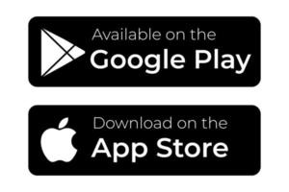
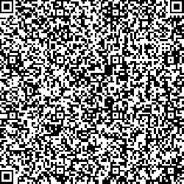
INSTRUCTIONS LANDING PAGE
An example of a landing page with instructions on how to download a wallet and claim credentials.
Web address presented on browser must be associated with the Issuer’s name. Otherwise, it will look suspicious.
Download a career wallet!
Congratulations! You are a few steps away from claiming ownership over your personal assessment results. Click here to learn more about career wallets
STEP 1
Download your free career wallet app to your device.
If you are reading this message on your device, click on the link to your app store below and install the app
If you are reading this message on your computer, visit the app store on your device, search for Velocity Career Wallet, and install the app.
STEP 2
Once the app is installed, you will need to your email and phone number verified. This will allow us to make sure you own the wallet we will send your records to.
Important Note! Make sure to use the email and phone number which you have provided when initiating your assessment with us. If the email and phone do not match, we will not be able to know it’s you when you will connect with us to claim your records.
STEP 3
Once you had your email and phone number verified , we can issue your records to your wallet.
If you are reading this message on your device, click here. It will open your career wallet, which will walk you through the process.
If you are reading this message on your computer, open the career wallet app on your mobile device. Use the wallet to scan this QR code:
Click the Scan QR Code button in your wallet app. Your device’s camera will open.
Hold your camera over the QR code so it’s clearly visible on your screen.
Once you have scanned the QR code, your wallet will walk you through the process.
PLEASE NOTE
Claiming your records should be an easy and quick process. Here are a few tips to help:
If you have any questions on how to use the wallet, privacy concerns, or anything else, click here for answers
If you experience any issues when claiming your records, please connect with us: XXXXXXXXXXXX
Use your career wallet to scan this QR code

